Slide 1
SECTION 1

Slide 2
Centralised human resources in commercial industries leads to greater productivity
Retail
Industrial
High demand and competition of space cause high land values
Residential
Land Value
Factories require good accessibility to markets and transport links
Residential buildings idealises large living space and cheap land values
Distance from Central Business District (CBD)

Slide 3
High accessibility to the market
High accessibility to labour
Decreasing housing density
Increasing quality of life
Decreasing land values
Increasing transport costs
Land Value
Lack of factories increases quality of life, forming middle-class residential
1
CBD
2
Factory zone
3
Working- class residential
4
Middle-class residential
Distance from CBD

Slide 4
1
Central Business District (CBD)
2
Factory zone
1
2
3
4
5
3
Working-class residential zone
4
Middle-class residential zone
5
Commuter zone

Slide 5



Slide 6
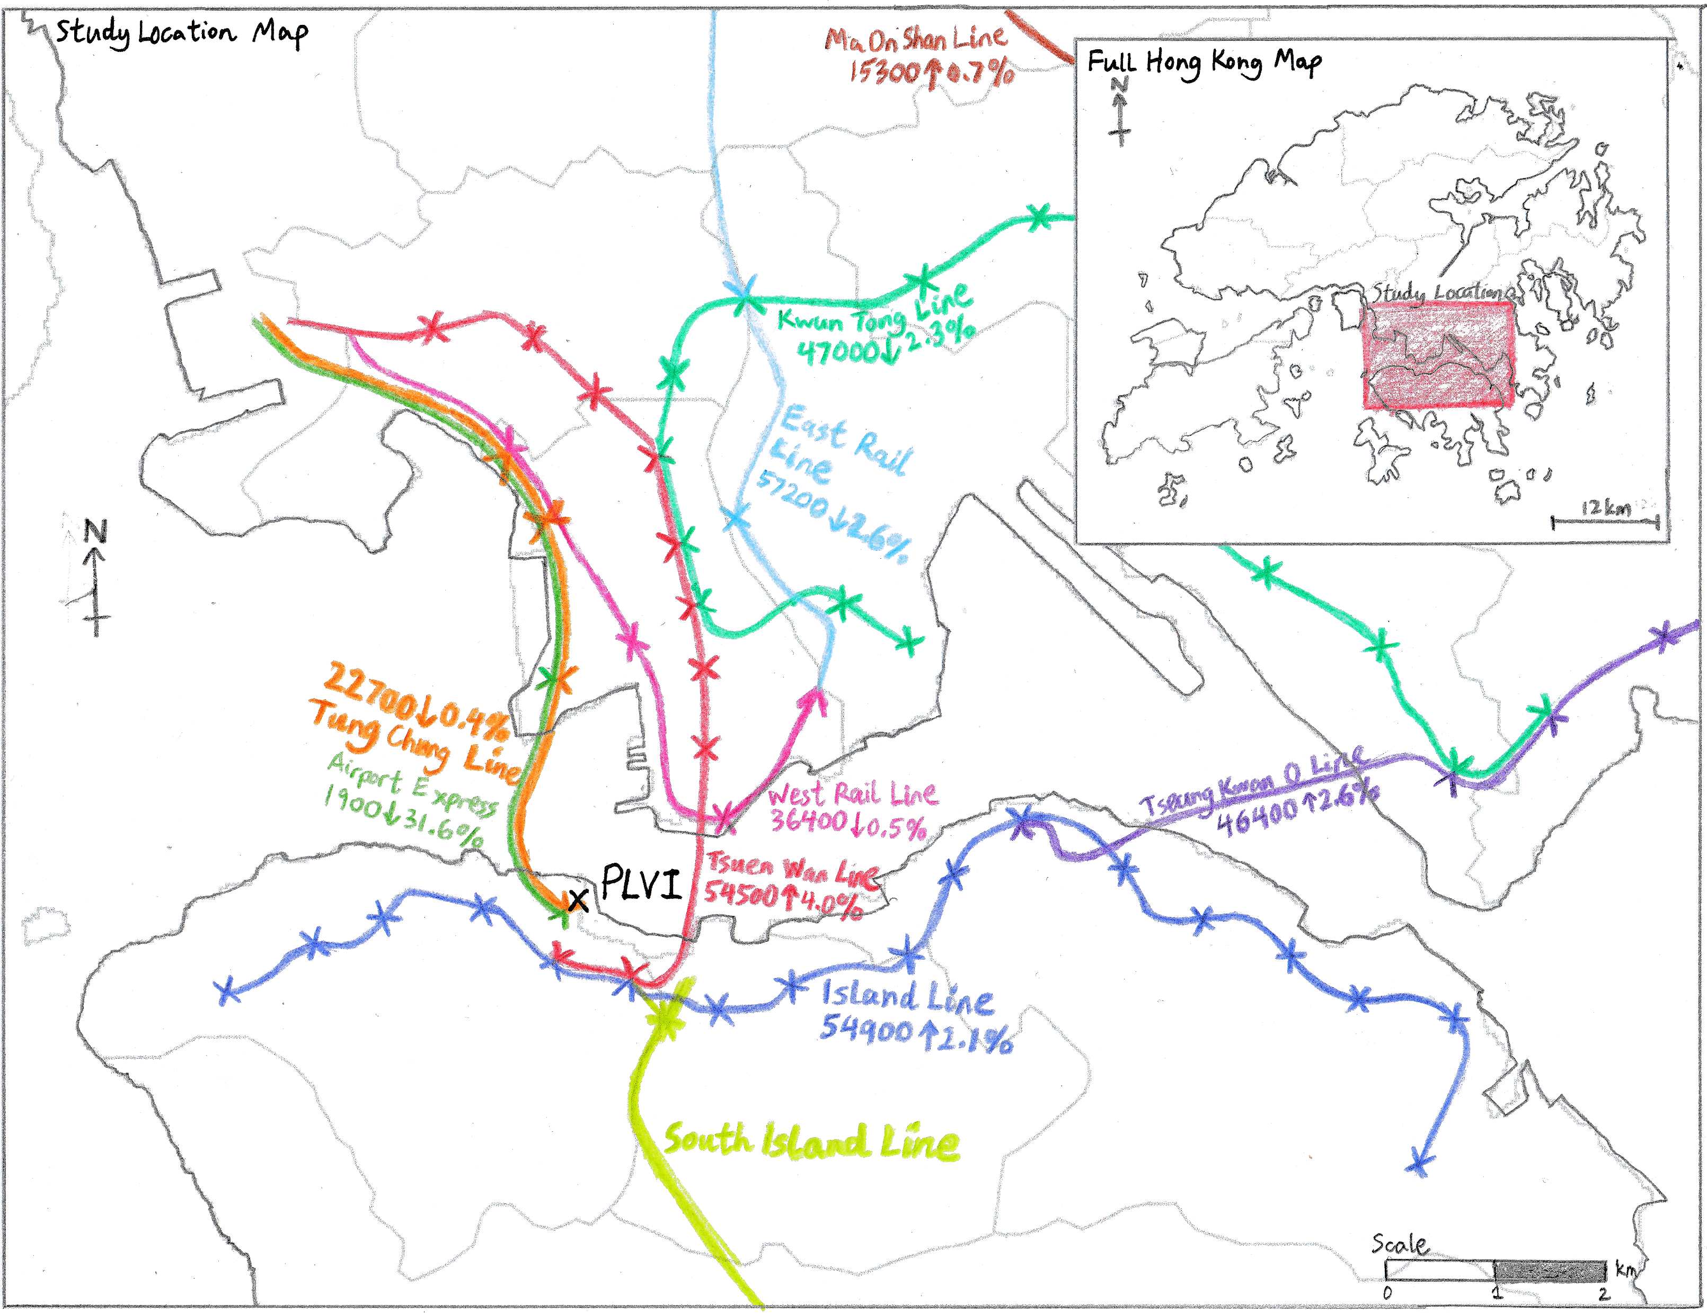
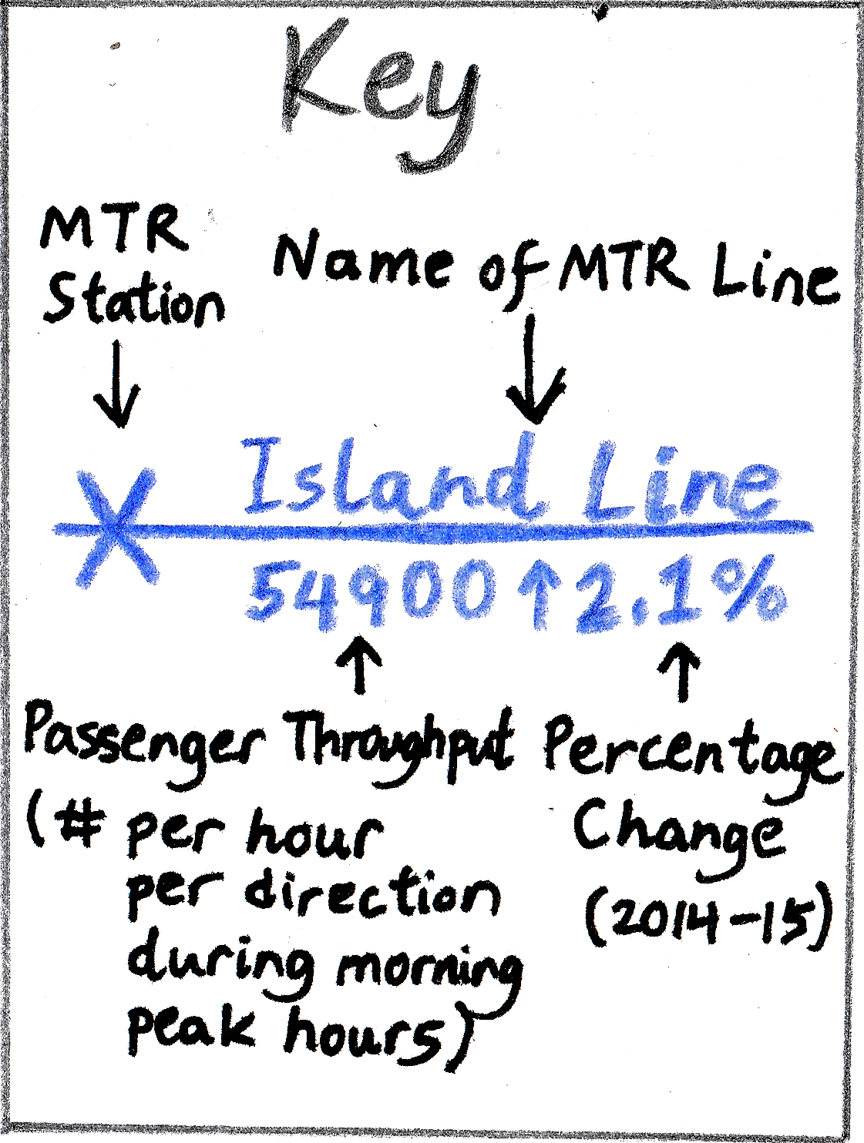

Slide 7
High accessibility to market and labour
Steep drop due to distinct difference in land use
Building Height
Central Business District
Major transport road directed towards the CBD
Inner City
Low-class residential
Middle-class residential
Desires to keep a distance from poor, low-class residential areas
High-class residential

Slide 8
Primary Central Business District
Secondary peak in land value
Building Height
Secondary Central Business District
Inner City
Desires be far away from pollution near industrial zones
Industrial Zone
Low-class residential
Middle-class residential
Accessible to smaller “nodes”
Zones specialised for single land use to maximise affordability
High-class residential

Slide 9
Local opposition deters urban renewal projects
Building Height
Average building height is low
Building Height
Building height may be lower than expected.
Technological Advancements and urban development
Distance
Distance
Low amount of population distributed across large area
Old buildings are demolished, replaced with taller buildings

Slide 10
SECTION 2

Slide 12
Decreasing scale
Step 1
Step 2
Step 3
Stratified sampling
Systematic sampling
Systematic sampling
N
Relative to street
For each transect
200m
200m
200m
For each interval
25m
W
E
PLVI
S
Four transects along the cardinal directions centred at the PLVI
Selecting buildings based on the four intercardinal directions
Regular 200m intervals along the transect

Slide 13
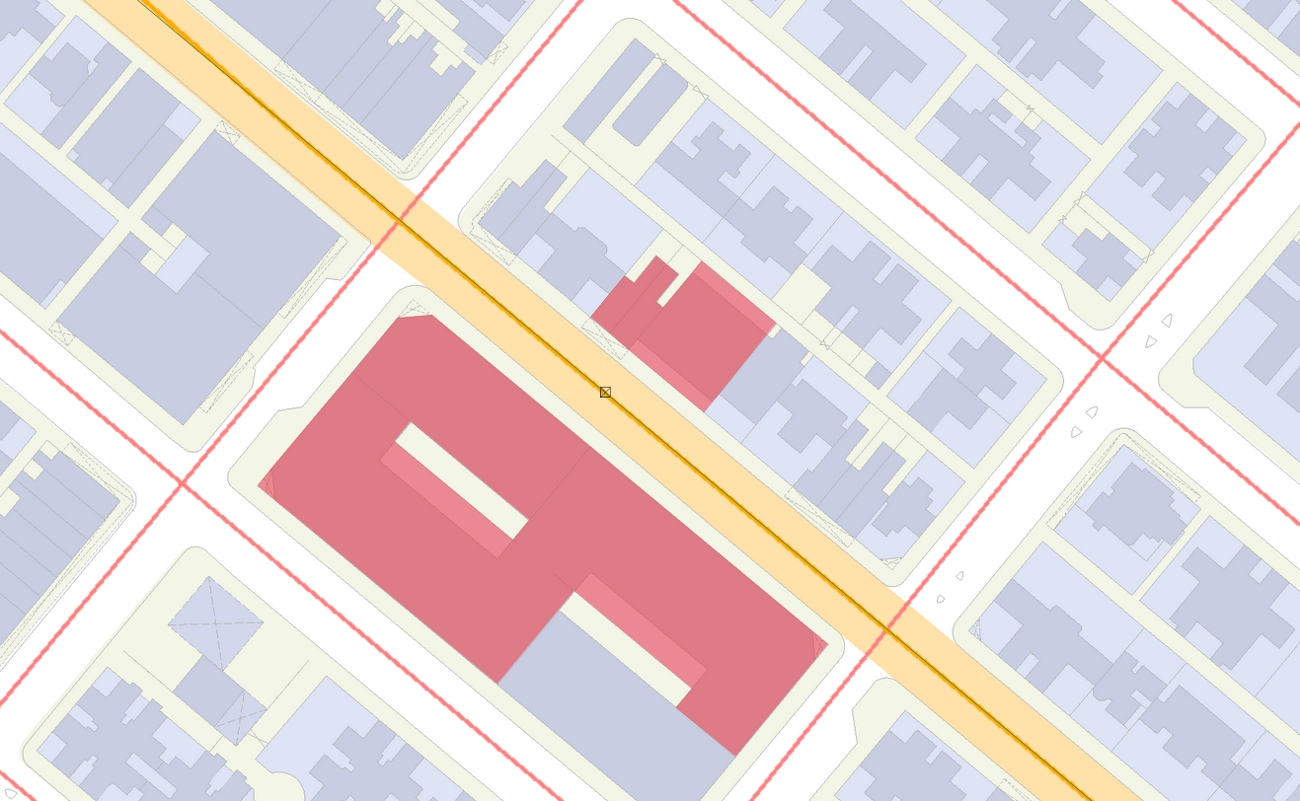
N
25m radius circle centred at the interval
Circle heading aligned with street, away from PLVI
A 20° deviation from the arrows is allowed
N24NE: 136-138 Castle Peak Road
N24NW: Price Theatre
N24SE: Wai Lee Commercial Building
Four arrows heading in intercardinal directions
Legend
Buildings in first contact with the arrow is selected
Selected Building
Podium
Tower
Road
N24SW: Hung Yu Mansion Block B
Street
25m

Slide 14
Worst-case road hierarchy
Buffer zone
5.25m
Buildings
Footpath
3.5m
Four-lane local distributor road
13.5m
Two-way tram tracks
Diameter: 50m
Radius: 25m
5.5m
Four-lane local distributor road
13.5m
Footpath
3.5m
Buffer zone
5.25m
Buildings

Slide 15
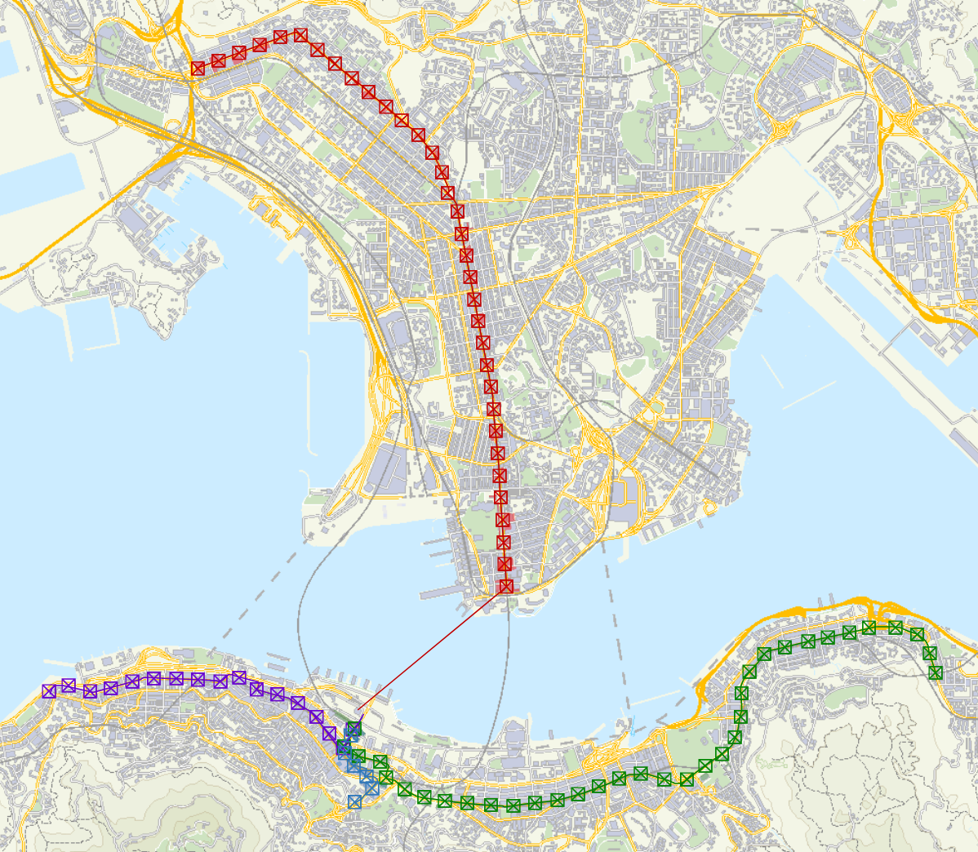




Legend
North:
Transect
N
Interval
Selected Building
East:
Major roads running along the N,E,S,W direction
Transect
Interval
Selected Building
South:
Transect
Interval
Selected Building
No buildings in the NW direction
West:
Transect
Interval
PLVI
1km

Slide 16
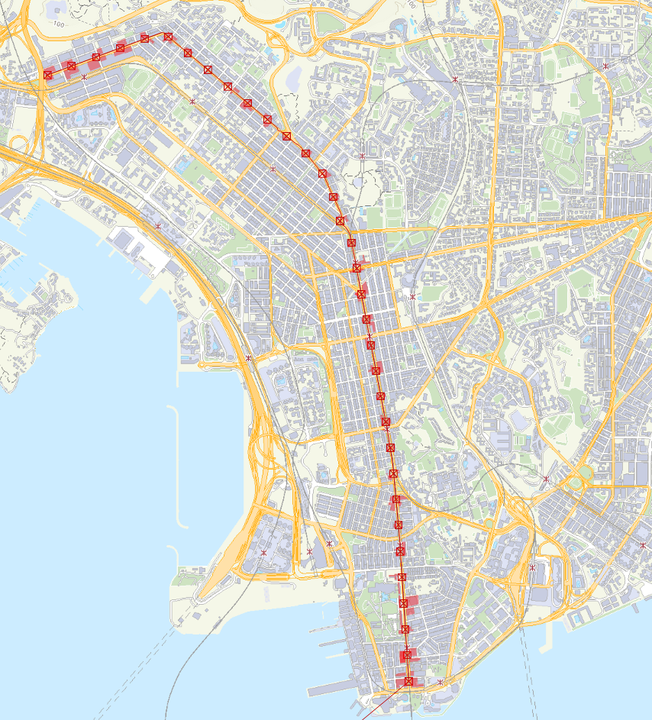
Single-way four-lane road, 21.1m wide
Legend
Transect
Interval
Selected Building
Transect moved upwards to avoid parks and government buildings
Runs along a major road with multiple MTR stations
Dual-way three-lane road, 21.5m wide
N
Towards PLVI
500m

Slide 17
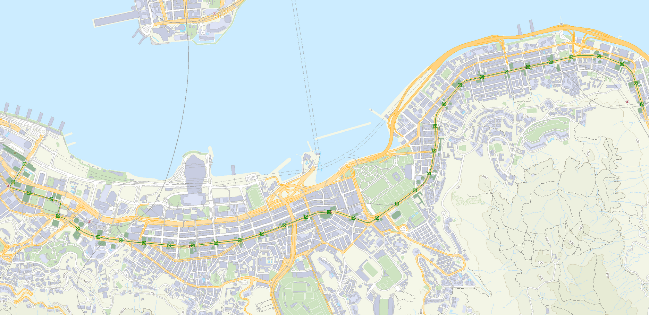
N
500m
Major road with multiple MTR and tram stations
Dual-way 2/3-lane road, 23.2m wide
PLVI
Legend
Dual-way three-lane road, 23.2m wide
Transect
Interval
Selected Building

Slide 18
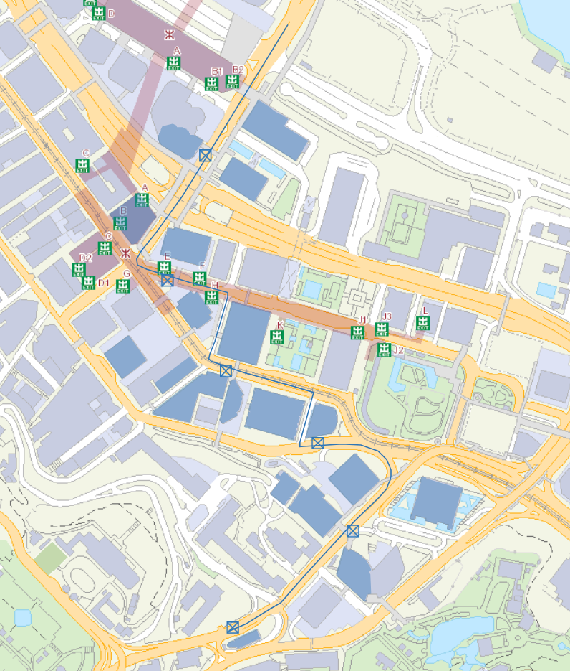
Legend
Dual-way two-lane road, 20.0m wide
PLVI
Transect
Interval
Selected Building
100m
N
Dual-way two-lane road, 9.9m wide
Dual-way three-lane road, 23.2m wide
Avoiding parks
Single-way four-lane road, 12.8m wide

Slide 19
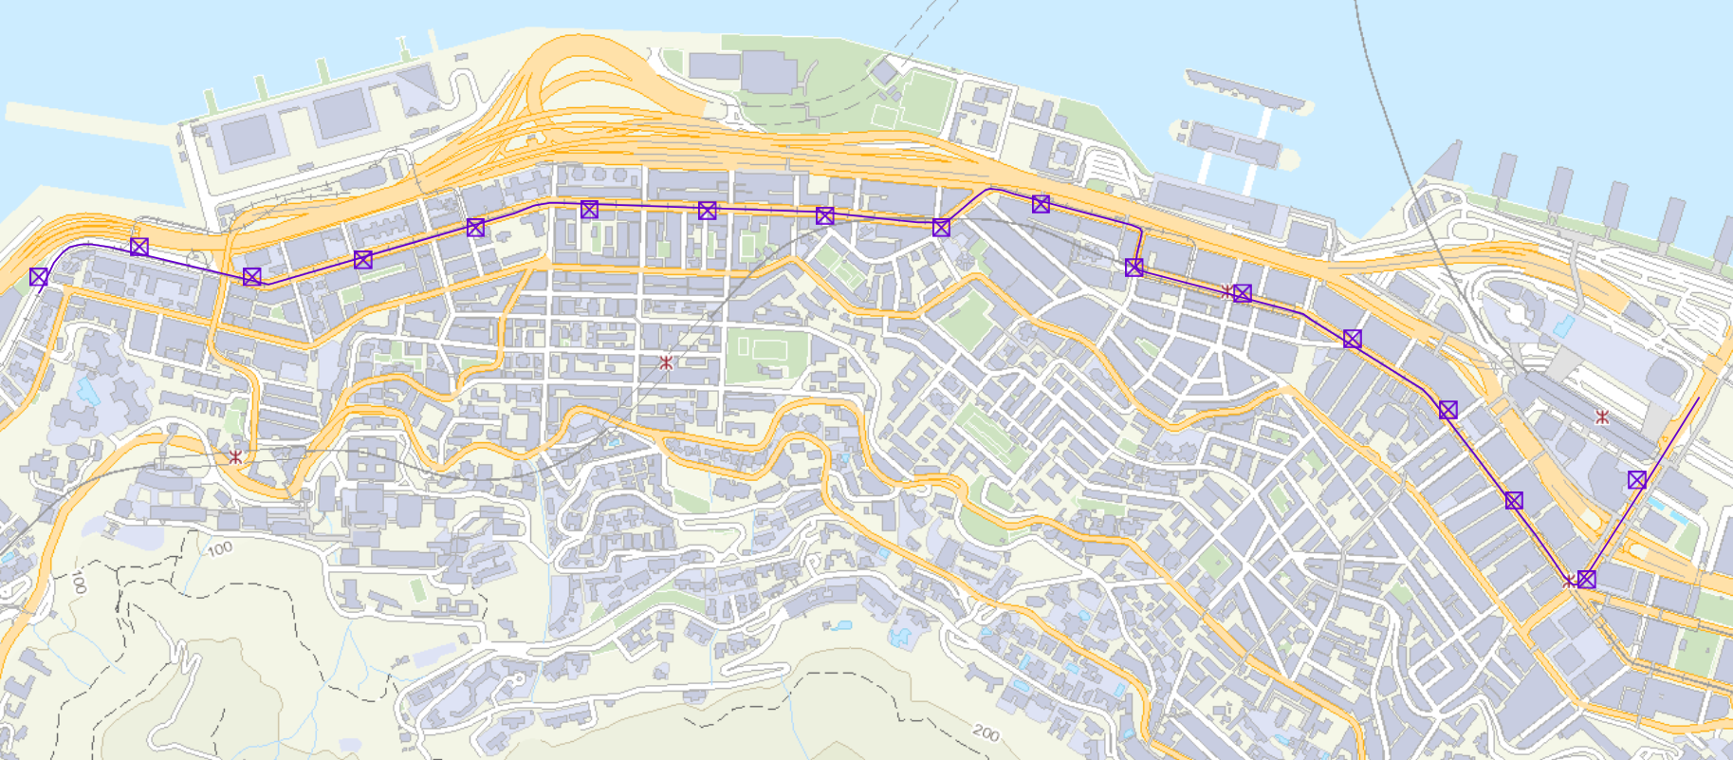
N
Avoiding seaside where there are no buildings
Legend
Transect
Interval
Avoiding parks
Dual-way 2-lane road, 16.5m wide
Single-way 1-lane road, 12.9m wide
Dual-way 2/3-lane road, 19.4m wide
PLVI
Dual-way 2-lane road, 16.3m wide
200m

Slide 20

Exclusion (Table 1)
N1NE
Outlier
N1SE
N1NE
1
N1SE
Std. Dev of N1SE, N1SW, N1NW
Mean of N1SW, N1NW
N1SW
N1NW
T-value
2.4.1
Standard Deviation Outlier Test
2.4.2
Spearman’s Rank Correlation Coefficient
2.4.2
Spearman’s Rank Correlation Coefficient
2.4.3
T-test
Rejection/acceptance of null hypothesis
R-value
N2NE
Std. Dev of N2NE, N2SE
Mean of N2NE, N2SE
2
N2SE
N2SW
N2NW
N2SW
Exclusion (Table 1)
N2NW
$$⋮$$

Slide 21



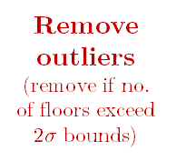

Code
#no of floors
N1NE
0
N1NE^
0
N1
N1SE
20
N1SE
20
N1SE
20
N1SW
25
N1SW
25
N1SW
25
Code
Mean
xRank
yRank
d²
Remove errors
(no buildings, construction sites etc.)
Remove outliers
(remove if no. of floors exceed $2σ$ bounds)
N1
22.5
1
1
0
N1NW
75
N1NW
75
N1NW
75
N2
33.5
2
2
0
N2NE
0
N2NE^
0
SRCC
$$⋮$$
N2SE
21
N2SE
21
N2SE
21
Data size
N2
R-value
N2SW
22
N2SW
22
N2SW
22
N2NW
24
N2NW
24
N2NW
24
T-value
For all
Critical t-value
$$⋮$$
$$⋮$$
$$⋮$$
For all
For all
Reject H₀?
Raw Mean
No Error Mean
Excluded Mean
Raw Std. Dev.
No Error Std. Dev.
Excluded Std. Dev.
Graph with all raw data
Graph with errors and outliers removed

Slide 22

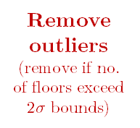




Code
#no of floors
N1NE
0
N1NE^
0
N1NE
0
N1SE
20
N1SE
20
N1SE
20
N1
N1SE
20
Combine data from all transects
N1SW
25
N1SW
25
N1SW
25
N1SW
25
N1NW
75
N1NW
75
N1NW
75
N1NW
75
E1NE
0
E1NE^
0
E1SE
20
Remove errors
(duplicate buildings*, no buildings, construction sites etc.)
E1SE*
20
N2NE
0
E1SW
24
E1SW
24
Remove outliers
(remove if no. of floors exceed $2σ$ bounds)
E1SW
24
N2
N2SE
21
E1NW
69
E1NW
69
E1NW
69
N2SW
22
Data size
N2NW
24
N2NE
0
N2NE
0
SRCC
R-value
$$⋮$$
N2SE
21
N2SE
21
N2SE
21
T-value
N2SW
22
N2SW
22
N2SW
22
Critical t-value
Code
#no of floors
Reject H₀?
E1NE
0
N2NW
24
N2NW
24
N2NW
24
E1SE
20
E2NE
0
E2NE
0
E1
E2SE
21
E2SE*
21
E1SW
24
E1NW
69
E2SW
23
E2SW
23
E2SW
23
E2NW
23
E2NW
23
E2NW
23
group by distance from PLVI
$$⋮$$
$$⋮$$
E2NE
0
$$⋮$$
For all
For all
For all
E2
E2SE
21
Raw Mean
No Error Mean
Excluded Mean
E2SW
23
Raw Std. Dev.
No Error Std. Dev.
Excluded Std. Dev.
E2NW
23
*there are some cases where the same building is used across several transects, so such duplicates will be removed.
$$⋮$$

Slide 23
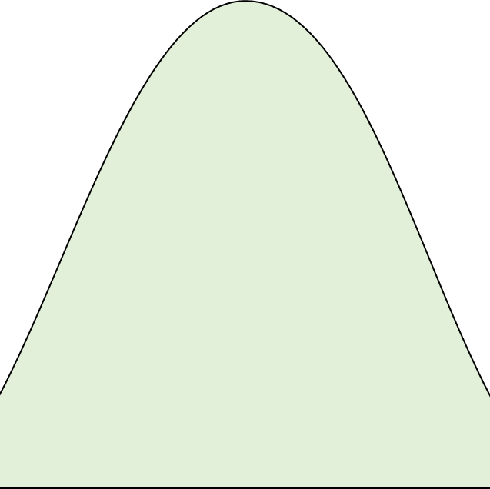
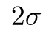
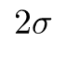
Normal distribution curve
Accept value
Probability Density
Represents 95.4% probability, for values within 2 standard deviations
Represents 4.6% probability, for values beyond 2 standard deviations
Reject value
$$2σ$$
$$2σ$$
Number of storeys
Mean

Slide 24

Rank by increasing order
In case of same ranks, take its average
Distance from PLVI, x
Rank of x, r(x)
Storeys, y
Rank of y, r(y)
Difference, d
d ²
0
0
69
5
-5
25
200
1
58
3,4 3.5
-2.5
6.25
400
2
58
3,4 3.5
-1.5
2.25
600
3
47
2
1
1
800
4
36
1
3
9
Sum, Σd ²
43.5
Perfect negative correlation
$−$1
R
1
Perfect positive correlation

Slide 25
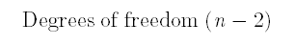
Critical t-value
Degrees of freedom (n $−$ 2)

Slide 26
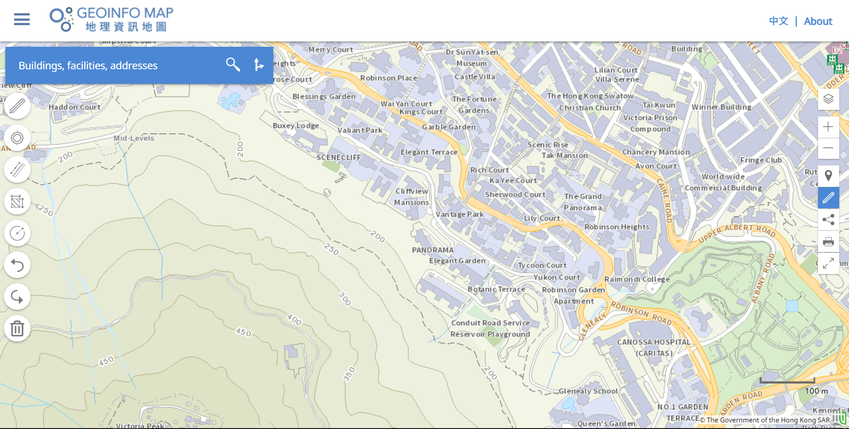
Highly accurate and official data from the government
Manual
Automated
ArcGIS Geocoding Service provided by the Lands Department
Internet
Transects are drawn precisely on GeoInfo Map
Google Sheets for further processing
Google MyMaps for collaborative visualisation
Transect is downloaded in the form of a KML document
CSV
KML
Python recursively splits transect into 200m intervals
Python queries a list of surrounding buildings at each interval
Python outputs list of buildings in CSV and KML formats
User select 4 buildings with visual guidance
Computer
Human error and selection bias eliminated

Slide 27
SECTION 3

Slide 28
Plot of Number of Storeys (raw) against Distance From PLVI along the North Transect
Key
Data point
Number of Storeys (raw)
Linear trendline
Distance from PLVI (m)
Plot of Mean Number of Storeys (errors and outliers removed) against Distance From PLVI along the North Transect
Key
Mean number of storeys (errors and outliers removed)
Data point
Linear trendline
Standard Deviation
Distance from PLVI (m)

Slide 29
Plot of Number of Storeys (raw) against Distance From PLVI along the East Transect
Key
Data point
Number of Storeys (raw)
Linear trendline
Distance from PLVI (m)
Plot of Mean Number of Storeys (errors and outliers removed) against Distance From PLVI along the East Transect
Key
Mean number of storeys (errors and outliers removed)
Data point
Linear trendline
Standard Deviation
Distance from PLVI (m)

Slide 30
Plot of Number of Storeys (raw) against Distance From PLVI along the South Transect
Key
Data point
Number of Storeys (raw)
Linear trendline
Distance from PLVI (m)
Plot of Mean Number of Storeys (errors and outliers removed) against Distance From PLVI along the South Transect
Key
Mean number of storeys (errors and outliers removed)
Data point
Linear trendline
Standard Deviation
Distance from PLVI (m)

Slide 31
Plot of Number of Storeys (raw) against Distance From PLVI along the West Transect
Key
Data point
Number of Storeys (raw)
Linear trendline
Distance from PLVI (m)
Plot of Mean Number of Storeys (errors and outliers removed) against Distance From PLVI along the West Transect
Key
Mean number of storeys (errors and outliers removed)
Data point
Linear trendline
Standard Deviation
Distance from PLVI (m)

Slide 32
Plot of Number of Storeys (raw) against Distance From PLVI along the Combined Transects
Key
Data point
Number of Storeys (raw)
Linear trendline
Distance from PLVI (m)
Plot of Mean Number of Storeys (errors and outliers removed) against Distance From PLVI along the Combined Transects
Key
Mean number of storeys (errors and outliers removed)
Data point
Linear trendline
Standard Deviation
Distance from PLVI (m)

Slide 33
SECTION 4

Slide 34
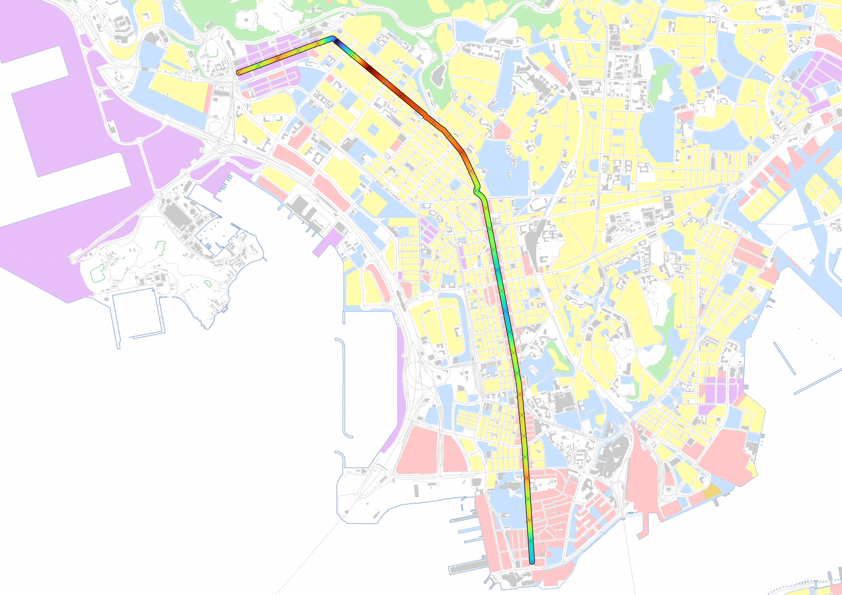

Legend
5
Roads
Mean number of storeys along transect
Shoreline
30
Buildings
Land use
Commercial use
Green Belt
N
Mixed commercial and residential use
Recreational use
Residential use
Industrial use
500m

Slide 35
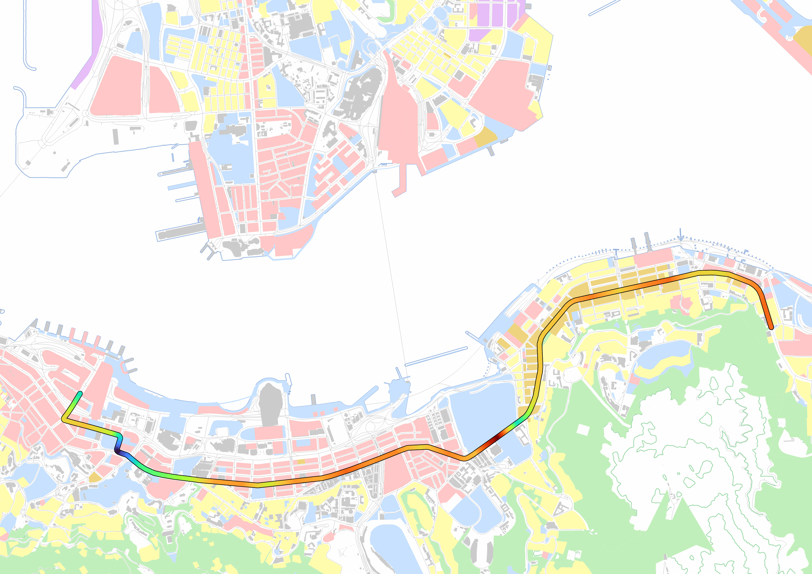
Legend
0
Roads
Mean number of storeys along transect
Shoreline
72
Buildings
Land use
Commercial use
Green Belt
Mixed commercial and residential use
Recreational use
Residential use
Industrial use
N
500m

Slide 36
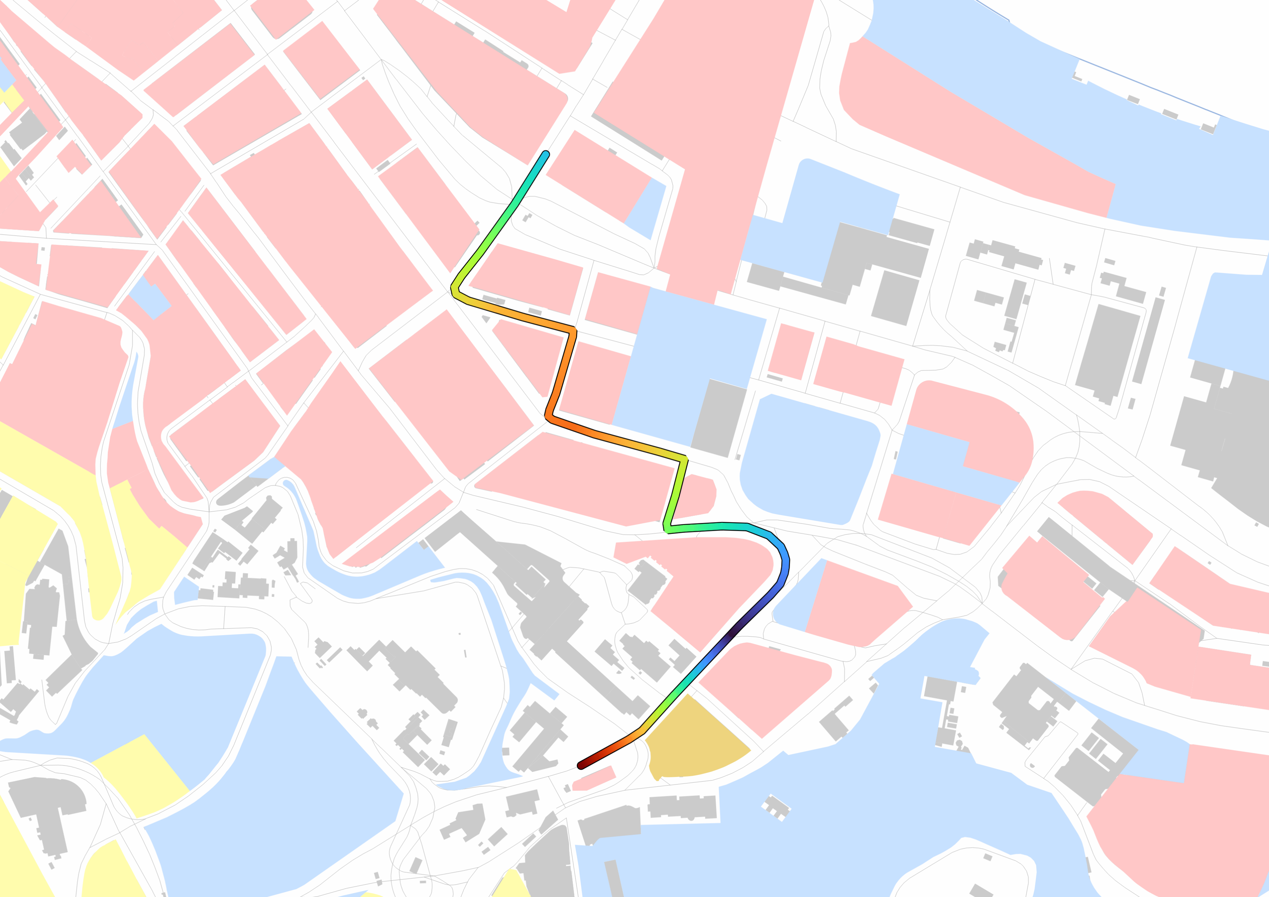
Legend
100m
22
Roads
N
Mean number of storeys along transect
Shoreline
58.5
Buildings
Land use
Commercial use
Green Belt
Mixed commercial and residential use
Recreational use
Residential use
Industrial use

Slide 37
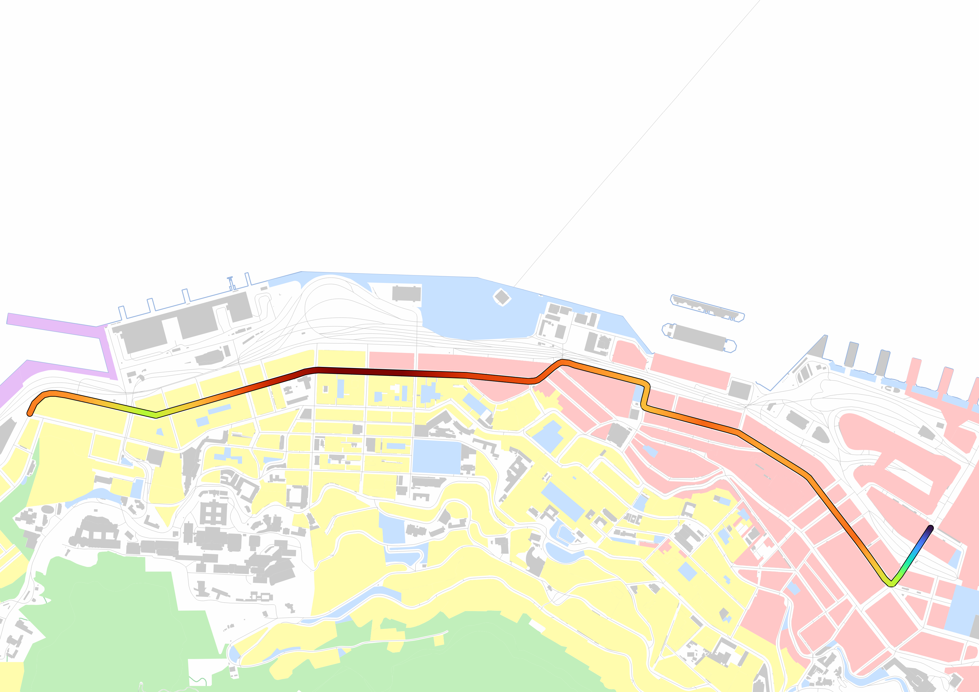
N
Legend
12.5
Roads
Mean number of storeys along transect
Shoreline
49
Buildings
Land use
Commercial use
Green Belt
Mixed commercial and residential use
Recreational use
Residential use
Industrial use
200m

Slide 38
1
2
3

Slide 39
N0-N15
N16-26
N27-33
E0-7
E8-18
E21-34
S0-5
W0-10
W11-12
W13-16
Different industries will compete space for higher profitability and accessibility
Land Value
At the expense of paying higher rent
1
CBD
2
Factory zone
3
Working- class residential
4
Middle-class residential
Distance from CBD

Slide 40
Gentrification at Lai Chi Kok
Secondary PLVI at Mong Kok
Secondary PLVI peaks disrupt steadily decreasing building height trends
Gentrification at Shek Tong Tsui
Secondary PLVI at Wan Chai

Slide 41
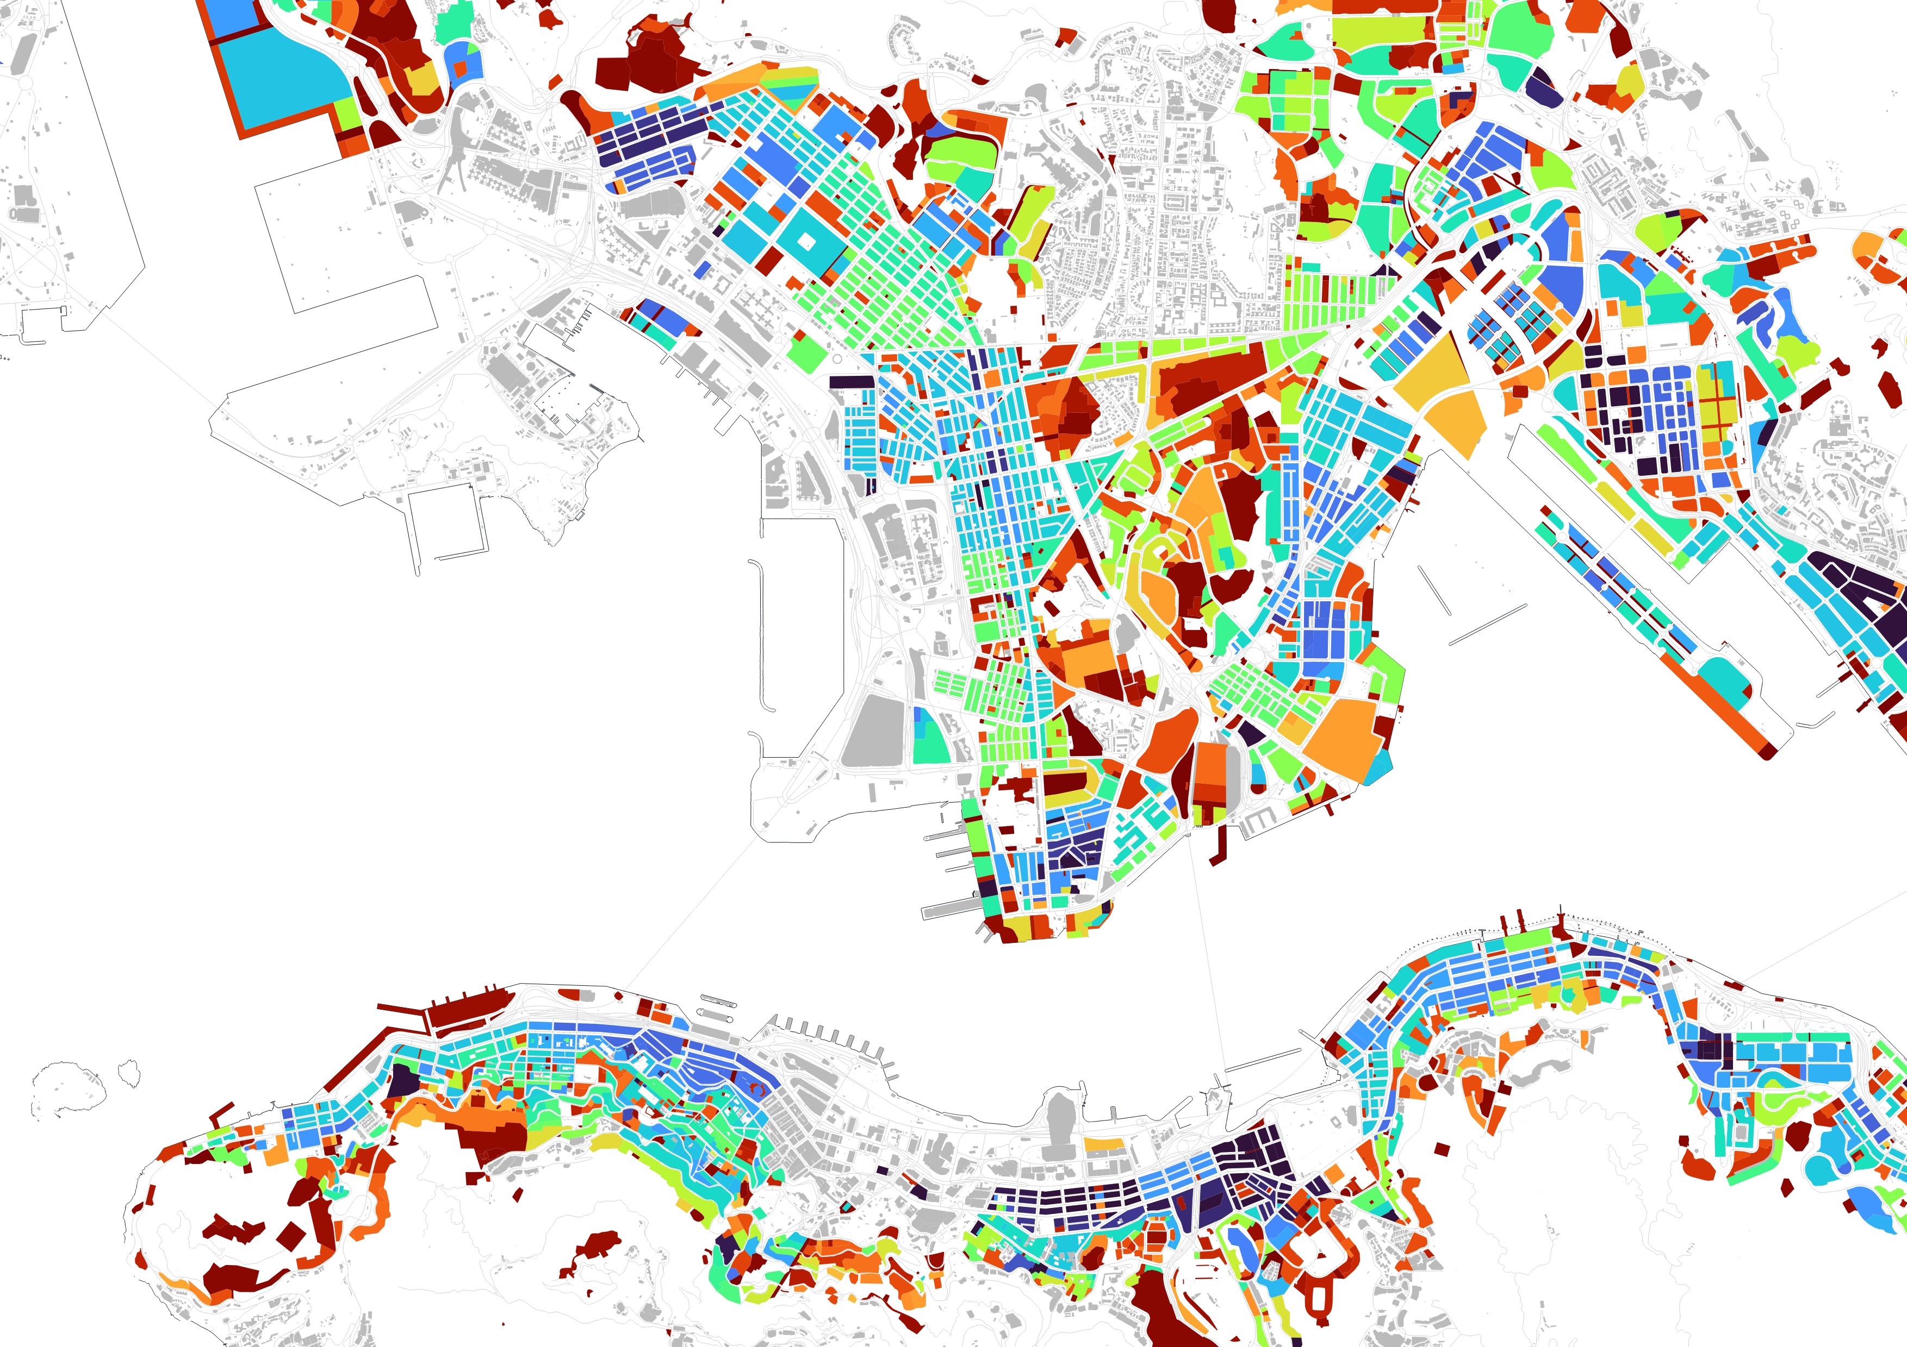
BHR used to encourage gentrification and increased building height
Legend
BHR along Nathan Road implies Sector Model
0
Roads
Building Height Restrictions (m)
Shoreline
>130
Buildings
Several spots where BHR is low to ensure breathability
Several spots where BHR is low to ensure breathability
N
BHR highly uneven, introduces variability

Slide 42
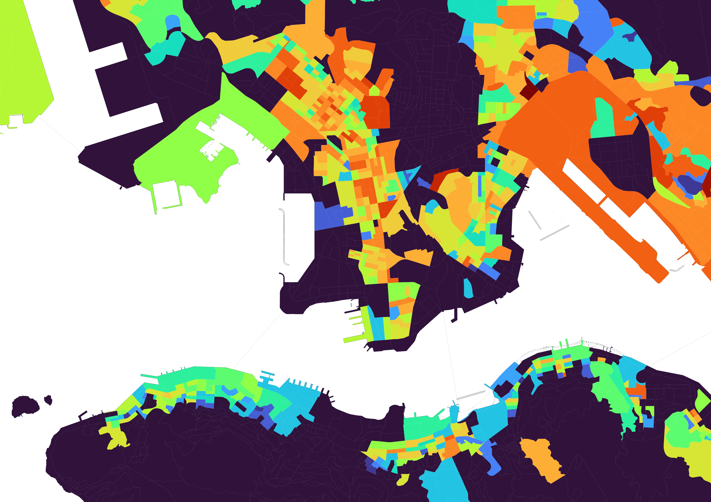
Legend
0
Median monthly domestic household income (HK$)
Large income inequalities, may suggest large disparities in land value
>40000
Shoreline
N

Slide 43
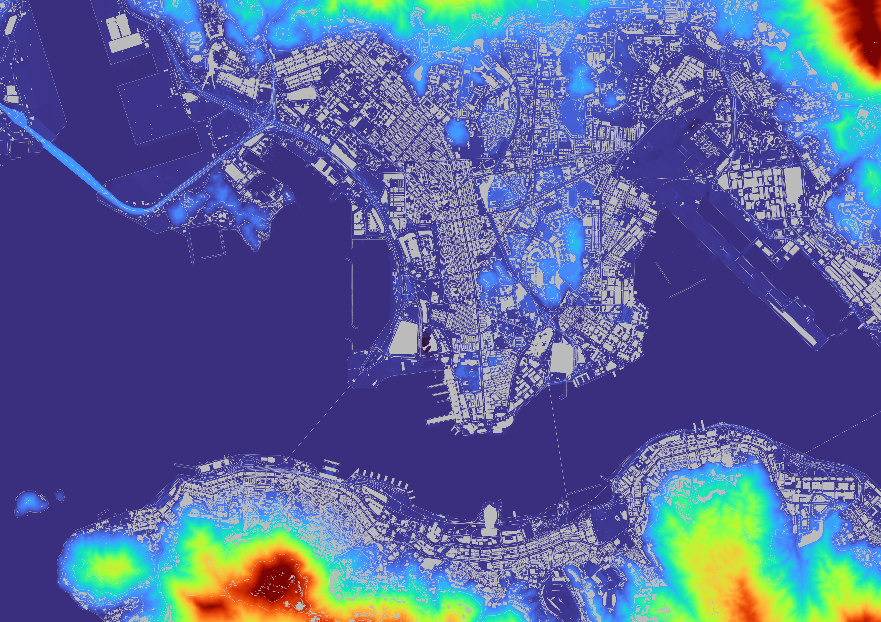
Urban sprawl hindered by mountainous terrain
Friction of distance causes many secondary PLVIs to form
Legend
0
Height above mean sea level (m)
Land mass surrounded by sea
>400
Roads
Buildings
VICTORIA HARBOUR

Slide 44
Select the next two adjacent buildings that separate lines
No buildings will be unintentionally missed out
Advantage of ensuring that buildings are included
Spaced 100m apart
Survey Point
Survey Point
Extend a line perpendicular to the road
Does not have to take in account of road width

Slide 45
Encounters fewer invalid locations
Passes through more buildings, hence more accurate data

Slide 46
Plot of Gross Unit Price of Residential Buildings against Building Height
Weak positive correlation between gross unit price and building height
Gross Unit Price (HKD/ft²)
Building Height (m)

Slide 47
Preservation of the Victoria Peak ridgeline
View overlooking the landscape increases land value despite low height
South
North
20%
Building height “distributed” due to height restriction
Steep gradient prevents urban sprawl in the Burgess Model
80%
PLVI
Victoria Harbor reduces buildable area
Beacon Hill

